Slide 1
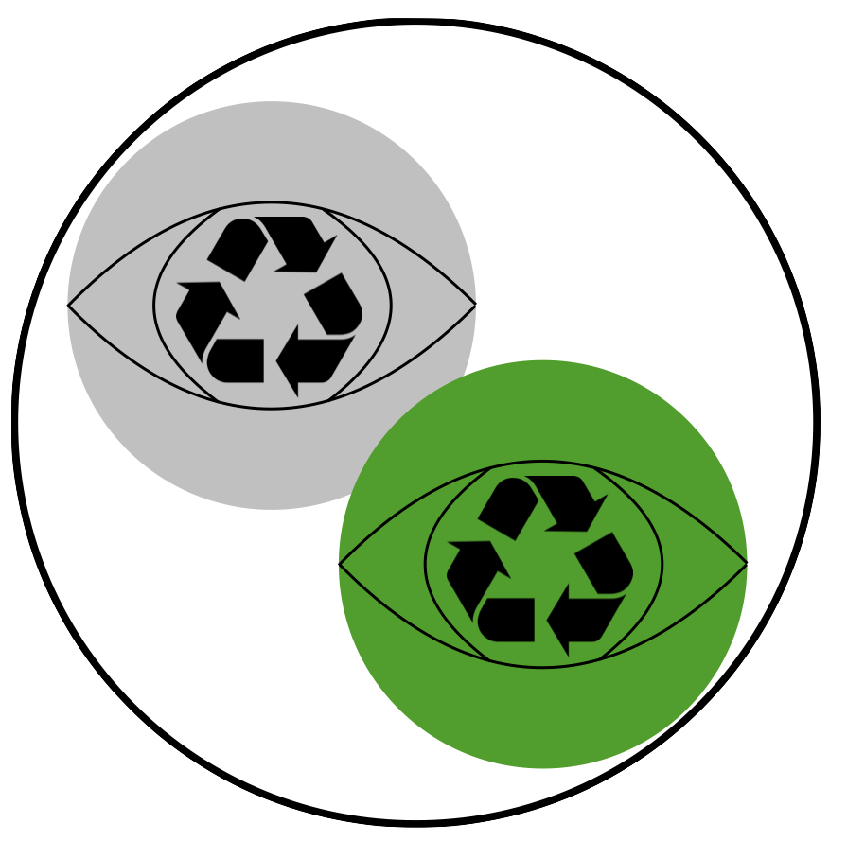
ReusabiliToken
Reduction of Plastic Waste
Claudio Cannizzaro, Prashanth Chandran, Silvano Cortesi, Philipp Fischer, Tatu Lindroos, Tobias Rohner
Notes:
Societal problem: We produce way too much waste from food product packages. Justification: Incentivise people to use their own cups and plates at coffee shops and restaurants instead of store-provided new plastics.
To address the challenge, we wanted to have a certified instance like a store to verify an action such as using a reusable cup at a coffeeshop.

Slide 2
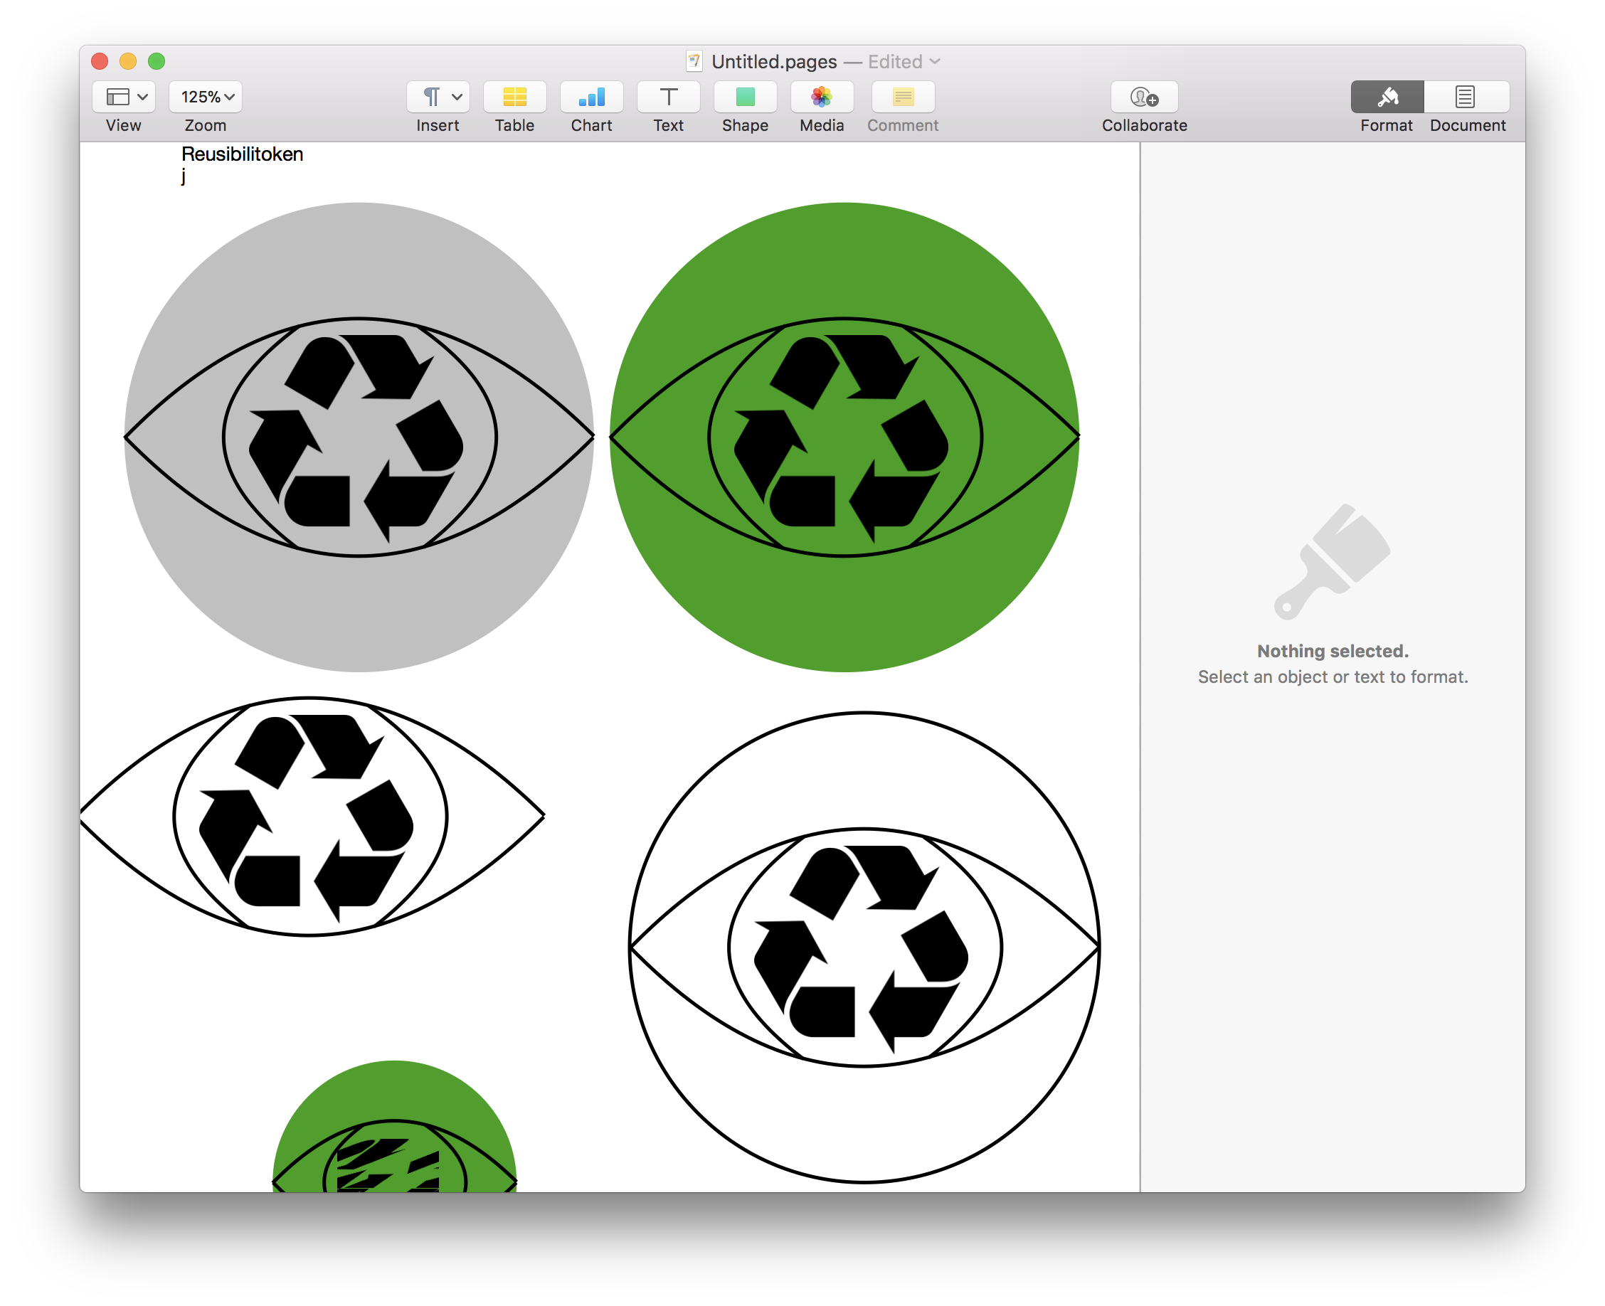

Concept
ReusabiliToken
Smart Contract
Value
Reputation
🔥
Customer
Store
Market
Reputation
Value
Notes:
The core concept is that if you reuse s/t at a shop, you get a token which you can use for rewards.
There’s also a reputation system, which is store dependent which incentives customers to go to the same store over and over again.
The value token is an ERC-20 token and thus tradable.
To incentive shops to sell stuff for token, there exist a fee to participate for them, thats only payable in this value token.
That’s also where the value tokens get burned.

Slide 3
Simulation of the Economy

Slide 4
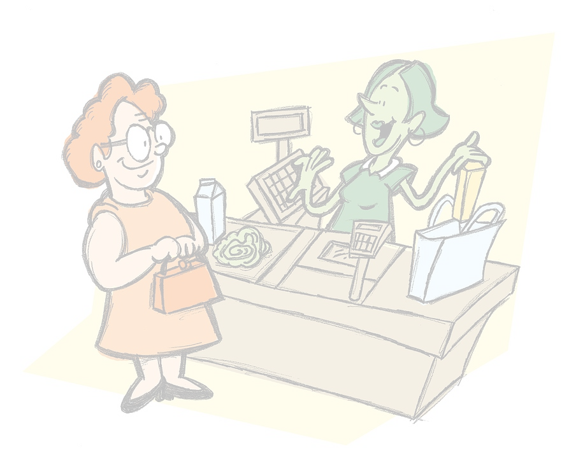
Implementation
Customer
Store
- Action type
Address
→ create QR - Code
QR
- Create Action type instance
- Store Shop ID
- Generate Signature for Hash
- Shop ID
Signature
→ create QR - Code
QR
- Add Store ID to Action
- Combine with Signature to get a valid claim
Background image license:
CC0 Creative Common
Notes:
We also implemented an operation to obtain the token:
Authentication:
Customer wants to buy coffee with a reusable cup
Customer shows a claim (“I want to reuse a cup”) and an account address as QR-code to the store cashier.
Store cashier scans the QR-code.
Store cashier generates another QR-code with its address and key.
Customer scans proved data and submits to Blockchain, claiming the tokens.
Blockchain checks if the key is valid, and if valid, gives tokens to Customer.

Slide 5
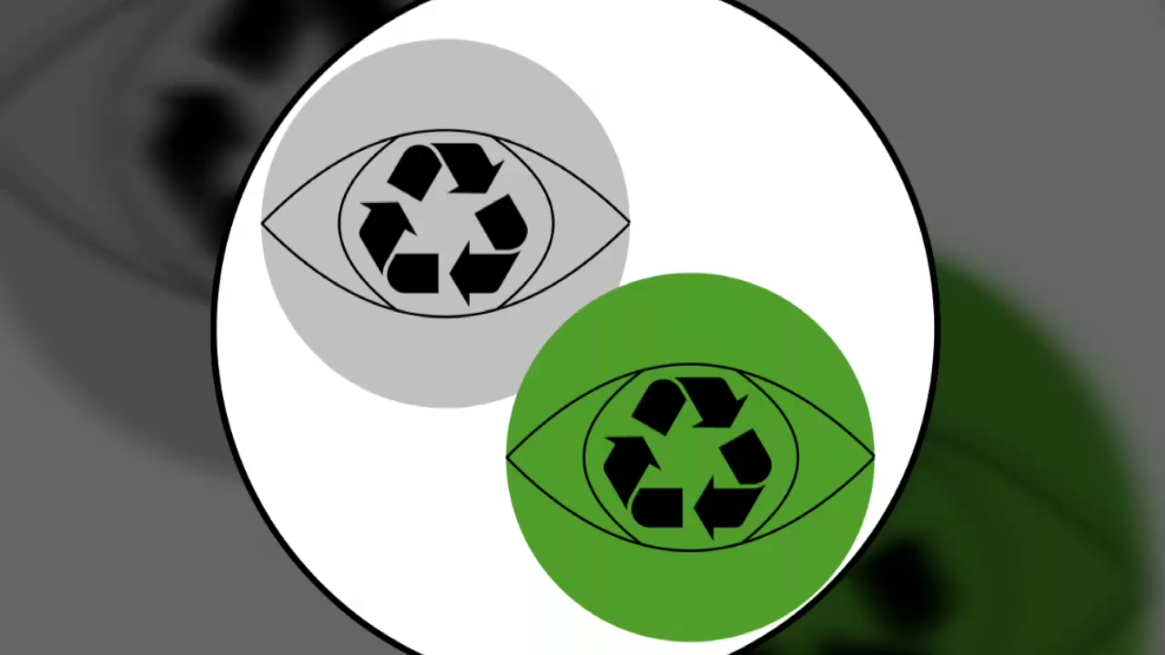
Demos

